Slide 1
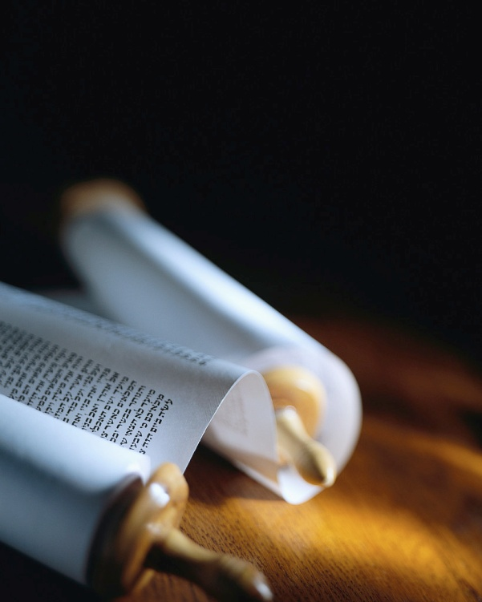
Next
Notes:
Let’s remember the mission of every true Christian :
1) You will be My witnesses. A1v8
2) The Seed is the Word. Lk8v11
3) Become Fishermen. Mk1v17
4) Salvation is of the Lord. Jo1v9
5) Make disciples. Mt28v19
But, can we know they are saved ?

Slide 2
Signs of Salvation
He said,
"Lord, I do believe,“
and worshiped him.
John 9:38 ISV
Obedience
Confession
Worship
Jesus brought him to salvation.
Next
Notes:
Jesus said, ‘By their fruit you will know them’ ≠ the fruit of HS
Today we’ll see 3 signs of salva.
I’ll be using the ISV literal transl
Let’s read Jn9v1-38. [Read]
Here’s our key verse. [Read]
Let’s remember that signs ≠ the Way to salvation but follow it.

Slide 3
Faith without works is dead !
[Jesus] told him, "Go and wash in the pool of Siloam" (which is translated "Sent One"). So he went off, washed, and came back seeing. John 9:7 ISV
Obedience
Confession
Worship
His obedience showed his faith.
Next
Notes:
Let’s re-read Jn9v7. [Read]
God’s Word in Ja2v20 & again in v26 says that true faith works.
This man could have refused.
He could have rubbed his eyes.
He did what JC demanded.
Faith comes first, but obeying is a sure sign of that faith.

Slide 4
The “Law of Christ” is to be obeyed.
The person who has my commandments and keeps them is the one who loves me. The one who loves me will be loved by my Father, and I, too, will love him and reveal myself to him."
John 14:21 ISV
Obedience
Confession
Worship
It shows when we love Christ.
Next
Notes:
Let’s read Jn21v21. [Read]
Ga6v2 reveals that although we are not under the law of Moses, we are to obey the law of Christ.
Disobedience is a sign that a person doesn’t know JC (Jn17v3).
The love of Christ constrains us to serve Him (2Co5v14).

Slide 5
Christ’s love draws out our love for Him.
If you keep my commandments, you will abide in my love, just as I have kept my Father's commandments and abide in his love. John 15:10 ISV
Obedience
Confession
Worship
Our model is the Lord Jesus Christ.
Next
Notes:
Let’s read Jn15v10. [Read]
We love because He first loved us.(1Jn4v19)
The order is important !
This is more than mentally keeping in mind His commands.
Our model is the Lord JC who obeyed His Father at all times.

Slide 6
Another sign of salvation is testimony.
The man answered them, "This is an amazing thing! You don't know where he comes from, yet he healed my eyes. John 9:30 ISV
Obedience
Confession
Worship
Public confession is important.
Next
Notes:
Let’s re-read Jn9v30. [Read]
This man told what Christ had done for him despite opposition.
Only someone for whom Christ had done a miracle could say it.
In Mk10v32 JC said, « Whoever confesses Me before men, him will I confess before my Father. »

Slide 7
He probably knew the consequences.
If this man were not from God, he couldn't do anything like that." John 9:33 ISV
Obedience
Confession
Worship
He was willing to speak of Christ.
Next
Notes:
Let’s re-read Jn9v33. [Read]
Everyone, including his parents, knew he would be thrown out of the Jewish community if he said Jesus was sent from God. (cf. v22)
Do we have this sign in our lives because we speak out for our Lord and Savior ?

Slide 8
His testimony was powerful.
They asked him, "You were born a sinner and you are trying to instruct us ?" And they threw him out. John 9:34 ISV
Obedience
Confession
Worship
We are all born sinners !
Next
Notes:
Let’s re-read Jn9v34. [Read]
Hallelujah ! The self righteous need to hear from sinners turned into saints by the Lord JC.
The message of the miracle of salvation is powerful when given by those who confess their sin.
No one is born without sin !

Slide 9
He was separated to the Lord.
Jesus heard that they had thrown him out. So when he found him, he asked him, "Do you believe in the Son of Man?" John 9:35 ISV
Obedience
Confession
Worship
He found the pure religion.
Next
Notes:
Let’s re-read Jn9v35. [Read]
He13v13 says, « Go to him outside the camp and endure the insults he endured.”
It is a real sign of salvation the day someone leaves the world for worship of the Lord Jesus Christ.
Ja1v27 says we have a religion !

Slide 10
This man met the Lord.
Yet the time is coming, and is now here, when true worshipers will worship the Father in spirit and truth. Indeed, the Father is looking for people like that to worship him. John 4:23 ISV
Obedience
Confession
Worship
Jesus revealed Himself to him.
Next
Notes:
Let’s read Jn4v23. [Read]
Like the woman at the well, a religious and local outcast, this man was sought out by God.
Like for the woman at the well, Jesus said, « I Am He ! »
Christ wants our worship as a sign that we are truly saved.

Slide 11
He worshiped Him.
He said, "Lord, I do believe," and worshiped him. John 9:38 ISV
Obedience
Confession
Worship
He knelt before the Lord.
Next
Notes:
Let’s re-read Jn9v38. [Read]
The Greek word for worship means kneel down.
True worship is in spirit AND in saying the truth.
This man now had eyes to see that were turned towards Jesus.
Are we known for our worship?

Slide 12
Review, React, Return
Obedience
Confession
Worship
He said,
"Lord, I do believe,“
and worshiped him.
John 9:38 ISV
www.Pass4missions.com/library
Notes:
Let’s review what we have seen
Let’s react to what we have learned from this blind man’s life AND be doers of the Word.
Let’s return for a checkup each day this week to see God work.
True Salvation is a miracle !
Let’s look for the signs of salva.

