Slide 1
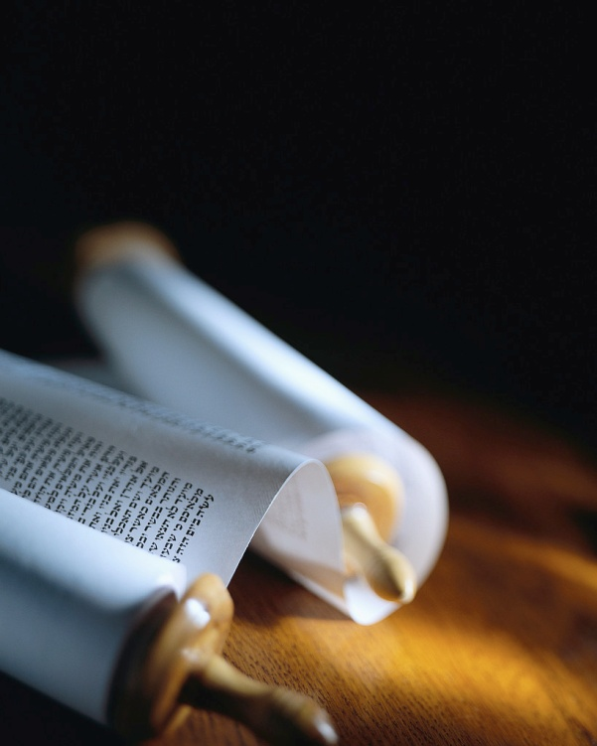
Next
Notes:
Let’s remember the mission of every true Christian :
1) You will be My witnesses. A1v8
2) The Seed is the Word. Lk8v11
3) Become Fishermen. Mk1v17
4) Salvation is of the Lord. Jo1v9
5) Make disciples. Mt28v19
But, can we know they are saved ?

Slide 2
Signs of Salvation
She had a sister named Mary, who sat down at the Lord's feet and kept listening to what he was saying. Luke 10:39
Listening
Looking
Loving
Just listening does not save you !
Next
Notes:
Jesus said, ‘By their fruit you will know them’ ≠ the fruit of HS !
Today we’ll see 3 signs of salva.
I’ll be using the ISV literal transl
Let’s read Lk10v38-42. [Read]
Here’s our key verse. [Read]
Let’s remember that signs ≠ the Way to salvation but follow it.

Slide 3
Listening to Christ is the way to faith.
Faith results from listening, and listening results through the word of the Messiah. Romans 10:17
Listening
Looking
Loving
Mary was “caught” by His Word.
Next
Notes:
Let’s read Rm10v17. [Read]
Mary came to trust Christ as she listened to Him.
The 1st recorded encounter with Christ, Mary made a decision.
Biblical salvation is not through a “leap in the dark”, nor does it continue as “blind faith” !

Slide 4
Saved people keep listening to Christ.
So Jesus told those Jews who had believed in him, "If you continue in my word, you are really my disciples. John 8:31
Listening
Looking
Loving
Daily listening to Him is normal.
Next
Notes:
Let’s read Jn8v31. [Read]
Jesus said it very plainly !
It’s a good sign of salvation when someone listens to Christ.
A lack of desire to hear God’s Word is a bad sign.
Is it “fanatic” to be a “fan” of the Word of God ?

Slide 5
Listening to God Word is a choice.
She had a sister named Mary, who sat down at the Lord's feet and kept listening to what he was saying. Luke 10:39
Listening
Looking
Loving
It should be top priority.
Next
Notes:
Let’s re-read Lk10v39. [Read]
Martha certainly greeted Jesus when He came into their house.
But, she rushed off to work !
There’s no sin in that, but it’s a bad sign about her salvation.
Mary “kept listening” ; she liked hearing the Master speak.

Slide 6
Looking to Jesus is a good sign.
Many of the Jews who had come with Mary and had observed what Jesus did believed in him. John 11:45
Listening
Looking
Loving
“Just follow my eyes !”
Next
Notes:
Let’s read Jn11v32-45. [Read]
Mary looked at Jesus with tears in her eyes and He began to cry.
He did not have to correct her view of Him as He did for Martha.
Jesus had called for her so that she could see the resurrection.
She brought others to Jesus !

Slide 7
Watch Him work in your life !
Fixing our attention on Jesus, the pioneer and perfecter of the faith, who, in view of the joy set before him, endured the cross, disregarding its shame, and has sat down at the right hand of the throne of God. Hebrews 12:2
Listening
Looking
Loving
Mary went to see Jesus.
Next
Notes:
Let’s read He12v2. [Read]
All truly saved Christians look to Jesus, “the author and finisher of our faith”.
It is not an option for super Christians, it is a normal sign of salvation.
Mary didn’t go to the tomb !

Slide 8
True salvation has always had this sign.
Seek the LORD and his strength. Always look to Him. 1 Chronicles 16:11
Listening
Looking
Loving
Give thanks, call, make known,…
Next
Notes:
Let’s read 1Ch16v8-12. [Read]
David reminds us to always that those God has saved always keep their eyes on Him.
There are 10 imperatives in the passage we just read.
That’s how truly saved people keep their eyes on the Lord.

Slide 9
Love shows itself by works.
Mary took a pound of very expensive perfume made of pure nard and anointed Jesus' feet. She wiped his feet with her hair, and the house became filled with the fragrance of the perfume. John 12:3
Listening
Looking
Loving
She gave her all.
Next
Notes:
Let’s read Jn12v1-3. [Read]
Love is like faith, without works it is dead !
Mary showed her love for Jesus in two ways : the cost & her hair.
She gave her very best, all she probably had PLUS her pride and position to be a slave for Christ.

Slide 10
It shows when someone loves Christ.
"If you love me, keep my commandments. John 14:15
Listening
Looking
Loving
The “law of Christ” is love.
Next
Notes:
Let’s read Jn14v15. [Read]
Doing what Christ asked is another sign someone is saved.
We are not robots ; we have free will to disobey.
Even a true Christian can refuse to obey, but it’s a really bad sign !
Ga6v2 says true Christians are…

Slide 11
The sign of love is part of the Gospel.
I tell you with certainty, wherever the gospel is proclaimed in the whole world, what she has done will also be told as a memorial to her." Mark 14:9
Listening
Looking
Loving
Jesus loves us in word and deed.
Next
Notes:
Let’s read Mk14v8-9 [Read]
The week between Palm and Resurrection Sundays was when Mary used her perfume.
That was almost 2k years ago.
A “memorial” is a sign that something great happened.
Mary’s love for JC is very clear !

Slide 12
Review, React, Return
Listening
Looking
Loving
She had a sister named Mary, who sat down at the Lord's feet and kept listening to what he was saying. Luke 10:39
www.Pass4missions.com/library
Notes:
Let’s review what we have seen
Let’s react to what we have learned from Mary of Bethany’s life AND be doers of the Word.
Let’s return for a checkup each day this week to see God work.
True Salvation is a miracle !
Let’s look for the signs of salva.

